Slide 1
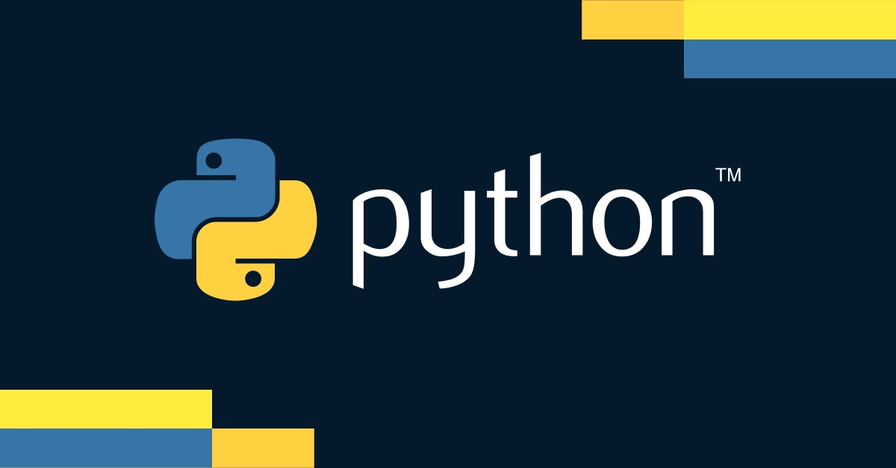

Slide 3
What is Django?
Overview
Django is a high-level Python web framework that enables rapid development and clean, pragmatic design
Purpose
Designed to help developers take applications from concept to completion as quickly as possible
Philosophy
Follows the DRY (Don't Repeat Yourself) principle, aiming to reduce repetitive code

Slide 4
Key Features of Django
Fast Development
Includes dozens of built-in features and components that accelerate the development process
Emphasizes reusable code and a modular design
Secure
Designed with security in mind to help developers avoid common security pitfalls such as SQL injection, cross-site scripting, cross-site request forgery, and clickjacking
It provides a secure way to manage user accounts and passwords
Scalable
Quick and flexible scaling makes it suitable for high-traffic websites
Uses a component-based "shared-nothing" architecture, meaning each part of the architecture is independent

Slide 5
Key Features of Django
contd…
Versatile
Django is suitable for both simple and complex web applications
Supports a range of different uses including content management systems, social networks, scientific computing platforms, and more
Robust
Built-in support for form handling, user authentication, and an admin interface
Encourages a clean, maintainable design

Slide 6
History of Django
Origins
Developed in 2003 at the Lawrence Journal-World newspaper to meet fast-moving newsroom deadlines
Created by Adrian Holovaty and Simon Willison
Public Release
Open-sourced under a BSD license in 2005
Named after Django Reinhardt, a famous jazz guitarist, reflecting its developers' appreciation for music
Django Software Foundation (DSF)
Established in 2008 to support and promote the development of Django
Ensures the long-term sustainability of Django

Slide 7
Django’s Popularity
Widespread Use
Used by many high-profile websites and applications such as Instagram, Spotify, Pinterest, and NASA
Strong community support with extensive documentation, tutorials, and forums
Community Contributions
Thousands of third-party packages are available to extend Django’s functionality
Regularly updated and improved, with new features and security update
Recognition
Frequently listed among the top web frameworks in various developer surveys
Appreciated for its simplicity, readability, and flexibility

Slide 8
Installing Django
Prerequisites
Ensure Python and pip (Python package installer) are installed
Verify Python installation by running :
python --version
or
python3 --version
Verify pip installation by running
pip --version
Installation Command
Use pip to install Django
pip install django
Verification
After installation, verify the installed version of Django by running :
django-admin --version

Slide 9
Creating a Django Project
Starting a Project
Create a new Django project with the command
django-admin startproject myproject
Project Structure
manage.py
A command-line utility for interacting with your project
settings.py
Configuration settings for your project
urls.py
URL declarations for the project
wsgi.py & asgi.py
For deployment using WSGI/ASGI servers
First Steps
Navigate to your project directory
cd myproject
Run the development server
python manage.py runserver

Slide 10
Running the Development Server
Starting the Server
Ensure you are in the project directory and run
python manage.py runserver
Accessing the Server
Open a web browser and go to http://127.0.0.1:8000/
You should see the default Django welcome page, indicating that the setup is successful
Server Output
You should see the default Django welcome page, indicating that the setup is successful

Slide 11
Running the Development Server
Starting the Server
Ensure you are in the project directory and run
python manage.py runserver
Accessing the Server
Open a web browser and go to http://127.0.0.1:8000/
You should see the default Django welcome page, indicating that the setup is successful
Server Output
You should see the default Django welcome page, indicating that the setup is successful

Slide 12

What principle does Django follow to reduce repetitive code?
Follows the DRY (Don't Repeat Yourself) principle
Name two security features provided by Django
Helps developers avoid common security pitfalls such as SQL injection and cross-site scripting
What does Django’s "shared-nothing" architecture imply?
It means each part of the architecture is independent, making it scalable
Which command is used to install Django via pip?
The command is
pip install django
What file in a Django project contains the URL declarations?
The urls.py file contains the URL declarations
What URL do you visit to see the default Django welcome page?
You visit http://127.0.0.1:8000/ to see the default Django welcome page

Slide 13
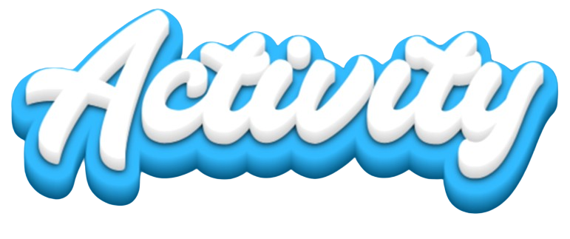
Create a simple "Hello, World!" Django application.

